Slide 1
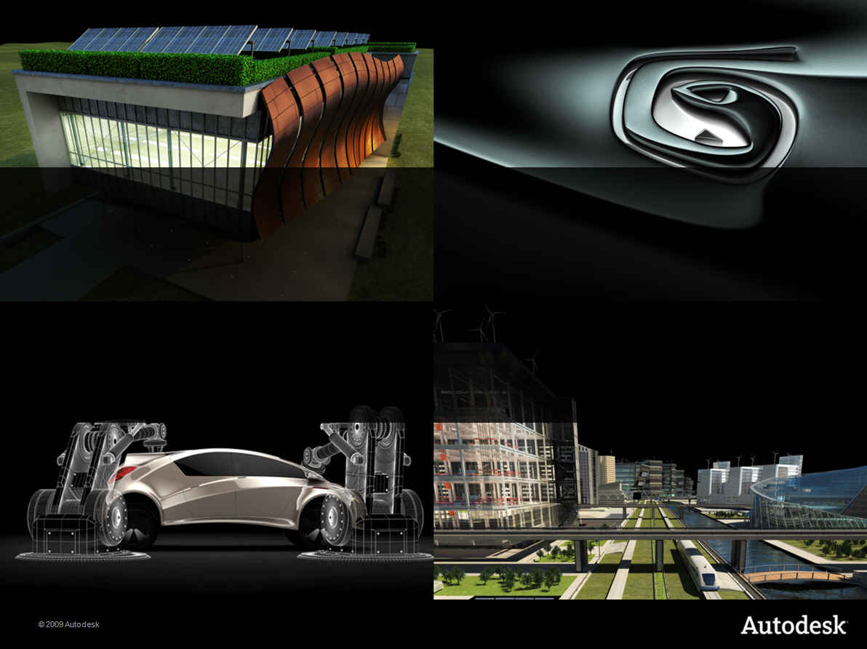
Revit 2012 API Updates
Jeremy Tammik and Saikat Bhattacharya
Developer Technical Services
® 2011 Autodesk Developer Network

Slide 2

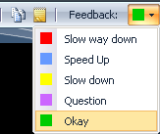
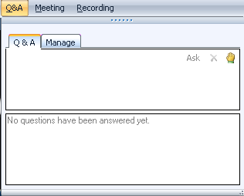
Before we start LiveMeeting and conference call – how to
Use Internet Audio
Full Screen Mode
Provide feedback
Real-time Q&A
Mute phone *6
Expand to full screen mode
Press ESC to return
Notes:
We encourage you to use the live meeting internet audio facility, rather than the telephone conference call.
If you wish to switch to full screen mode, please click the Full Screen button located at the bottom right corner of the Live meeting console.
If you wish to provide feedback on the speed of delivery, you can use the Feedback function located on the top right corner of the screen asking us to either speed up or slow down.
This conference is muted, so you cannot hear anybody else than me talking, and cannot provide feedback through the phone conference. We will unmute it and open it up for general discussion and questions and answers at the end. Meanwhile, written questions can be entered in the live meeting console and will be answered in real-time during the presentation by my colleagues.
You can use *6 to mute your phones
And we will be recording this session and will post the materials from this presentation together with the recording online.

Slide 3
Today’s presentations…
Recorded and posted at:
ADN Extranet
Revit > Knowledgebase > Whitepapers and Training Videos
Developer Center
API Training & Consulting > Schedule

Slide 4
Polls
What category best describes your main professional activity?
Architect, Engineer, Constructor, Programmer, Manager, Other
How would you rate your level of experience with Revit products?
Very experienced, Quite experienced, Not experienced
How do you rate your level of experience with the Revit API?
Very experienced, Quite experienced, Not experienced
Which statement best describes you?
This topic directly affects my work today, I expect this topic to be useful to me in future, I’m evaluating this technology, None of the above

Slide 5
Agenda
Revit 2012 New Product Features
Overview: API and SDK
Migrating Revit 2011 add-ins to Revit 2012
Revit 2012 New APIs
Geometry API
Construction modeling
Point Clouds
Updates in Revit Structure API
Break
Extensible Storage
Compound Layer Structure
Updates in Revit MEP API
New SDK samples
Conclusions

Slide 6
Revit 2012 New Product Features
New Feature Themes

Slide 7
Revit 2012 New Product Features
Construction Modeling
More detailed geometric information to manage construction workflows
Analysis and Visualization
Detailed environmental and element relationship information
Display more types of analysis results
Large Team Workflow
Access to Worksharing information
Interoperability
Point clouds
Notes:
Revit 2012 concentrates on several items –
It continues our focus on construction modeling which will benefit our users working on building fabrication.
It makes more information of the model available to API users to enable better analysis and manipulation of the model. This is appropriate for construction, cost analysis or any other task which require far more detailed understanding of the model.
In conjunction with worksharing features, we now have access to work-sharing information which has been a highly requested feature
On the interoperability front, Revit 2012 now supports point clouds

Slide 8
Overview: API and SDK
SDK and getting started

Slide 9
Revit 2012 SDK
The SDK is provided with the product
From Installer under “Install Tools and Utilities”
Web and download version
<extraction folder>\Utilities\SDK\RevitSDK.exe
SDK Installer in Revit 2012 RTM temporary setup files
C:\Autodesk\Autodesk_Revit_Architecture_2012_English_Win_32-64bit\Utilities\SDK\RevitSDK.exe
Latest SDK update will be posted to Revit Developer Center
http://www.autodesk.com/developrevit
Notes:
The Revit SDK is basically purely for support and documentation purposes.
The SDK install is located under the 'Install Tools and Utilities' menu on the main page of the Revit installer.
Alternatively, you can also find the SDK installer in the Revit 2012 temporary set up files under:
C:\Autodesk\Autodesk_Revit_Architecture_2012_English_Win_32-64bit\Utilities\SDK\RevitSDK.exe
The latest SDK updates are always posted to the Revit Developer Center and should be downloaded from there to get the latest.

Slide 10
SDK Documentation
Read once
Getting Started with the Revit API.doc
Revit Platform API Changes and Additions.doc
Keep at hand always
Revit API Developer Guide.pdf
RevitAPI.chm
What's New section is similar to Changes and Additions doc
Read if needed
RevitAddInUtility.chm – installer
Revit Server SDK – file access on server
REX SDK – Revit extensions framework
Point Clouds Indexer API
Important utilities
Add-In Manager
RevitLookup
VSTA Samples
Samples
Revit Wiki Help: http://autodesk.com/revitapi-wikihelp new! in 2012
Notes:
Here are the top level contents of the SDK.
For getting started, we recommend you read through the Getting Started With Revit API document and also can look at the Revit Platform API changes and additions document to get a snapshot of what has changed in Revit 2012 as compared to the previous release.
The Developer Guide is very comprehensive pdf document with focus on each API topic split across various lessons. The Revit API chm file is another great resource where you can search for specific APIs. The Whats New Section in this file highlights the new APIs in Revit 2012.
Besides this, as shown in the slide, there are a number of other resources specific to certain APIs which can be of great help.
The Revit SDK samples provide a huge knowledgebase on how to address specific programming tasks using the Revit API. The API documentation in the help file lists all the classes and their methods and properties, and the developer guide and samples explain and demonstrate how they work together to solve specific tasks.
With Revit 2012, now the product and API help system has taken the next step by moving to a online wiki-based system which provides support for a full community learning experience.

Slide 11
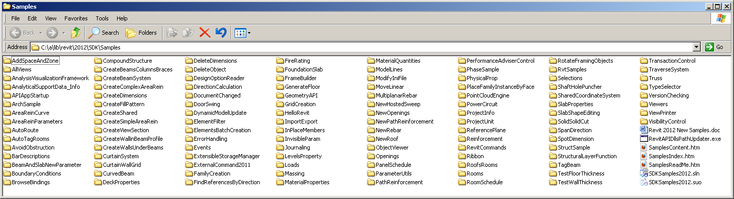
Revit SDK Samples
Documentation
Revit 2012 New Samples.doc
SamplesReadMe.htm
Utility
RevitAPIDllsPathUpdater.exe
Main samples solution
SDKSamples2012.sln
And the samples themselves!
Notes:
The Revit SDK samples provide a huge knowledge base on how to address specific programming tasks using the Revit API. The SDK also contains documentation for each of sample on which API they cover, description of the sample and the APIs used therein and instructions on how to run the samples.

Slide 12
Where to get started with Revit API
Introduction to Revit API
DevTV: Introduction to Revit 2011 Programming (Part 1 and 2) on Revit Developer Center
Webcast and AU recordings
Developer Center > API Training and Consulting > Schedules > Webcast Archives filter by “Revit API”
AU online classes look under “customization and programming” track
Notes:
If you are new to Revit API and programming with Revit, please refer to the links shown on the slide for more information on getting started. You can begin by looking into the DevTVs which is available in two parts and is an efficient learning resource for quickly getting a hands-on experience of programming with Revit. The first part covers the basic steps to start developing with Revit .NET API and the second part focuses on selection and filtering API through a room renumbering application.
Besides this, the developer center provides webcasts covering the introduction to Revit API and can be accessed from the webcast archive section as shown in the slide.
The content posted on the Autodesk University site includes materials (like PPTs, handouts, etc) on the various online classes which have been presented in the past and provide a great resource for learning more about the Revit API.

Slide 13
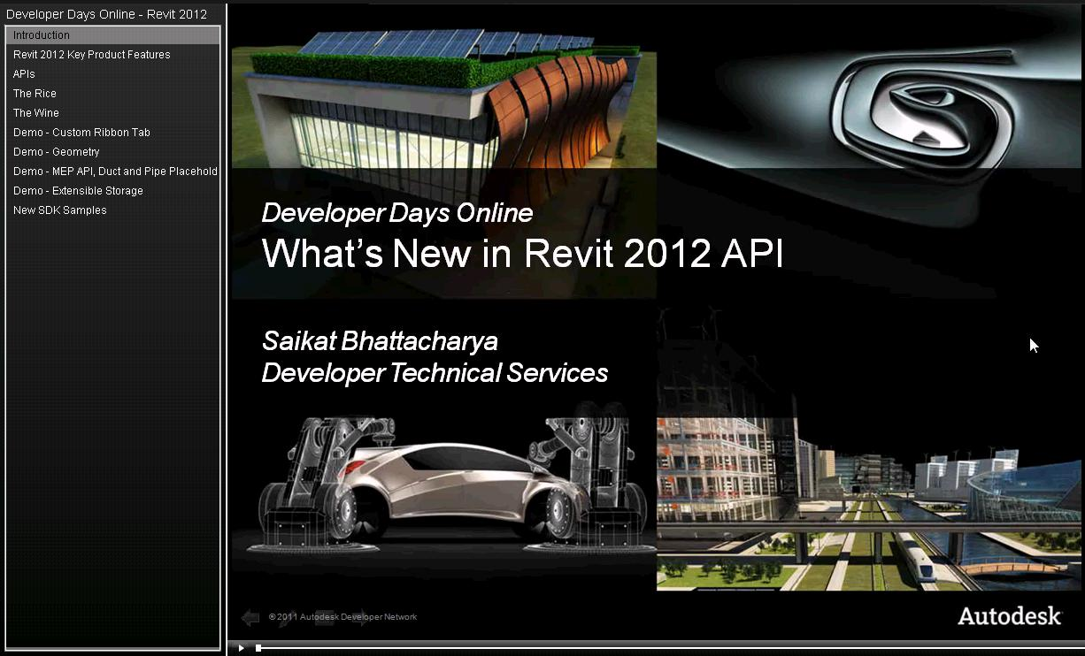
Revit 2012 APIs Overview
Today’s presentation
discuss selected Revit 2012 API topics in depth
DevDay Online recording
- Complete overview of 2012 new features
- Available from the Developer Center webcast archives
Notes:
Today’s presentation covers selected areas of the Revit 2012 API in depth as has been talked about in the Agenda.
To obtain an complete overview of all the new features in the Revit 2012 API, please refer to the DevDays Online Revit 2012 API recording available from Developer Center webcast archives:
http://download.autodesk.com/media/adn/DevDay_Online-Revit_2012_API.zip
An overview of the Revit 2012 API features is given in:
http://thebuildingcoder.typepad.com/blog/2011/03/revit-2012-api-features.html
The contents of the DevDays Online Revit 2012 API recording are described in:
http://thebuildingcoder.typepad.com/blog/2011/04/devdays-2010-online-with-revit-2012-api-news.html

Slide 14

Revit 2012 API Modifications and Updates
.NET Framework 4.0
No .ini file add-in loading
Vendor identification tag
Manual regeneration mode
Compound structure and wall sweeps
Line and fill patterns
Independent tag
Import and export APIs
Save and close API changes
Reference properties
Event changes
Move/Mirror/Rotate/Array changes
Structural analytical model and rebar changes
Notes:
Revit 2012 API has been enhanced to run with MS .NET framework 4.0
INI files can no longer be used to load plug-ins
In manifest files, it is now mandatory to provide vendor information via vendor id.
Automatic regeneration mode has been removed
The new compound structure API covers all the data that is visible in Revit’s user interface related to walls layers and compound structure
The wall sweeps API covers the sweeps inside compound structure as well as standalone sweeps
The line pattern and fill pattern classes have been replaced – the old classes contained the line pattern itself and the element that contained it, now we have explicit classes for the line pattern, the element that contains it besides Create method for these
Good portion of the Independent tag have been renovated besides some new methods which help access the Id of the element referenced by a tag.
The import and export APIs require view inputs
Save and close APIs have been changed to logically split the DB only and the UI
Reference properties are being renovated to be closely aligned to native Revit class it represents thus making it easy for code generation
Similar changes/renovations to the Events, Move, Mirror, Rotate and Array APIs
Structural Analytical and Rebar changes will be covered in this presentation

Slide 15

Revit 2012 API New Features
Open and activate document, set active view
Custom ribbon tab
Worksharing API
Geometry enhancements
Analysis of room and space 3D geometry
Detailed energy analysis
Conceptual energy analysis
Analysis visualization framework enhancements
MEP API enhancements
Rebar enhancements
Construction modeling
Point clouds
Extensible storage
Notes:
Many of these items resolve very frequent and long-standing requests.
We can now open and activate document, set the active view
We can also create our own ribbon tab in the UI
Another popular request has been worksharing and with the new API, we can access the list of worksets, list the elements in the workset, etc
Besides this, in today’s presentation, we will be covering at depths with the geometry API enhancements, construction modeling API, Extensible Storage API and take a quick look at the new Point Cloud API and MEP and RST API enhancements.

Slide 16
Migrating Add-Ins to Revit 2012
Migrating existing Revit 2011 add-ins to Revit 2012
Notes:
This section covers the list of API changes that have to be done to existing Revit applications so that they continue to run with Revit 2012.

Slide 17
Migration
Revit uses .NET Framework 4.0 (VSTA .NET 3.5)
Visual Studio
VS 2008 (no debugging) or
VS 2010 with framework target of .NET 3.5 or 4.0
Add-manifest
No more .ini file
<VendorId>ADSK</VendorId> (must)
<VendorDescription>Autodesk, www.autodesk.com</VendorDescription> (optional)
RDS: Registered Developer Symbol www.autodesk.com/symbreg
Re-reference managed modules
RevitAPI.dll
RevitAPIUI.dll
Notes:
Revit 2012 API has now been enhanced to run with MS .NET 4.0 runtime
Use Visual Studio 2010 with framework target of .NET 3.5 or 4.0
The existing Addins compiled with VS 2008 will continue to work but will run outside debug environment
With changes to the manifest file in Revit 2012, the INI file can no longer be user to load an add-in.
It is now mandatory to provide a Vendor Id in the manifest file. The Vendor id is a mandatory string which conforms to the Autodesk’s Registered Developer Symbol (Or the RDS) standard. This Vendor Id should be a 4-character “prefix” registered with Autodesk as per Autodesk’s vendor Id Standard.
The VendorDescription is an optional string which contains the vendor’s legal name and other pertinent information. This vendor description might be show up in pop-ups error messages saying whom to contact in case of errors.
In your existing plug-ins, you will have to re-reference the two Revit API dlls to make them run in Revit 2012 using its API.

Slide 18
Migration (cont.)
Regeneration
Manual regeneration mode only
Remove regeneration attribute >> no effect if you keep it
Use Document.Regeneration() when you need to access geometry after the creation/modification
Signature changes, e.g.,
Document.Import(). .Export
Compound Structure and wall sweeps
For more information
“Revit Platform API Changes and Additions.docx”
RevitAPI.chm >> What’s New in Revit 2012 API help
Notes:
As was warned in Revit 2011, the automatic regeneration mode for external applications has been removed. This means that the regen is in the control of API users and is also their responsibility. You have to notify Revit of regeneration after your work is done. For example, if you wish to access geometry of an element after you have created or modified it, we need to regenerate the model to be able to access the updated geometry.
Besides these basic and most important steps in migrating your existing Revit API plug-ins to Revit 2012, there is an extensive list of API changes and if your application is using any of the changed API, you would need to make the corresponding changes in your application to be able to make it work with Revit 2012. For example, there are some signature changes with the Import/Export APIs, compound structures, etc.
For a complete list of changes, please refer to the Revit 2012 SDK documentation and especially the chapter 'What's New' in the Revit 2012 API help file RevitAPI.chm for more details

Slide 19
Geometry API
Geometry Creation, Boolean Operations and Utilities

Slide 20
Geometry API
Extract the original geometry of a family instance
Before cuts or joins have been applied automatically
GeometryCreationUtilities - Construct basic solids
CreateBlendGeometry()
CreateExtrusionGeometry()
CreateRevolvedGeometry()
CreateSweptGeometry()
CreateSweptBlendGeometry()
BooleanOperationsUtils - Execute a boolean operation
ExecuteBooleanOperation()
ExecuteBooleanOperationModifyingOriginalSolid()
GeometryObject.IsElementGeometry
Options m_options = new Options();
GeometryElement orginalGeo = instance.GetOriginalGeometry(m_options);
Notes:
Geometry API has been a major focus area in Revit 2012 API.
With the new enhancements, now we can access the beam, column geometry before the fitting and joining happens in the model which is done by Revit. FamilyInstance.GetOriginalGeometry() returns the original geometry of the instance before the instance is modified by joins, copings, cuts, extensions, and other post-processing steps.
We can now construct basic solid shapes from input curves using the GeometryCreationUtilities. They include blend, extrusion, revolved geometry, swept, and swept blend geometry. The resulting geometry is not added to the document as any element but can be used as inputs for finding 3D intersection, boolean or geometric operations or input faces to AVF.
We can now also execute boolean operations like Union, Difference or Intersect on pair of solid geometry objects using a utility called BooleanOperationsUtils.

Slide 21
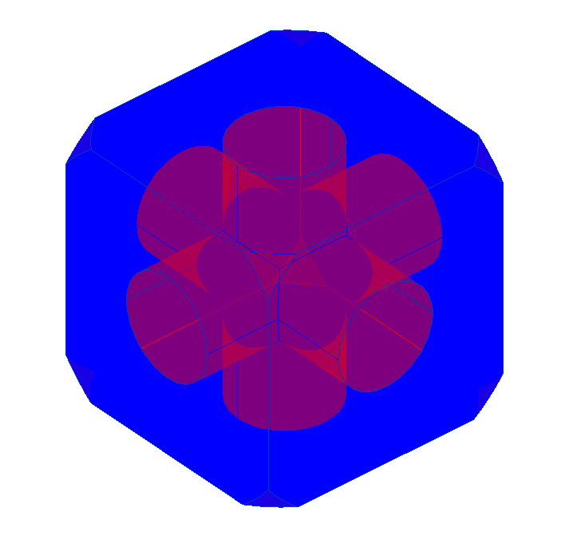
Geometry API
Demo: GeometryCreation_BooleanOperation
Shows the usage of GeometryCreationUtilities and BooleanOperationsUtils

Slide 22
Geometry API
HostObjectUtils - locate the faces of a given roof, floor or wall (host objects)
ExtrusionAnalyzer - Allow fitting a geometry into the shape of an extrusion
Geometry Filters - find elements that intersect the solid geometry of element
ElementIntersectsElementFilter
ElementIntersectsSolidFilter
Notes:
Geometry API now provides shortcuts to locate the face of a given roof, floor or wall – basically host objects, using HostObjectUtils.
We can also fit a given geometry into the shape of an extrusion using the ExtrusionAnalyzer class.
Revit 2012 API has new geometry filters which help find elements whose actual 3D geometry intersects the 3D geometry of target object. With ElementIntersectsElementFilter, the target object is another element.
With ElementIntersectsSolidFilter, the target object is any solid, including one created from scratch using GeometryCreationUtilities. Both these filters are slow filters.

Slide 23
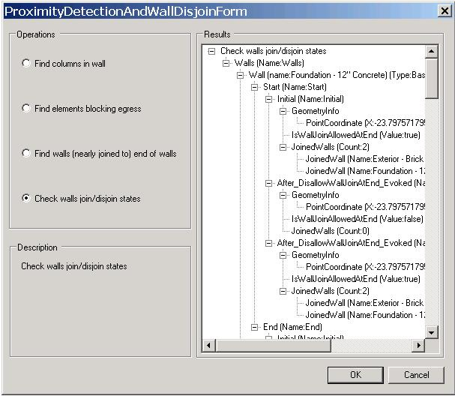
Geometry API
Demo: ProximityDetection_WallJoinControl
Shows the usage of ElementIntersectsElementFilter and ElementIntersectsSolidFilter

Slide 24
Geometry API
FamilyInstance.HostFace - Access the reference to the host face of a family instance
Regeneration and geometry status - If updated geometry has not been Regenerated before accessing, Element.Geometry throws exception
GeometryObject.GraphicsStyleId - Access to ElementId of family primitive’s GraphicsStyle
Edge.AsCurve() - Provide a curve that corresponds to the edge
Solid.ComputeCentroid - Calculate the centroid of a solid
Reference corbelHostFace = corbel.HostFace;
Notes:
We can now get the reference to the host face of family instance, or if the instance is placed on a work plane, the reference to the geometry face underlying the work plane.
Element.Geometry has been modified to throw an exception if an updated geometry has not been Regenerated before accessing it.
We can access the ElementId of family primitive’s GraphicsStyle
The Geometry API provides a curve that corresponds to a edge
And we can also calculate the centroid of a solid. This will correspond only with the center of gravity if the solid represents a homogeneous structure of a single material.

Slide 25
Geometry API
Transformation
GeometryElement.GetTransformed() - Return a copy of the geometry transformed
Instance.GetTransform() – return the transform of the instance
Instance.GetTotalTransform() – return the total transform (e.g., true north transform of an imported instance).
Serialization/deserialization of Reference
Reference.ConvertToStableRepresentation() - convert a reference to a stable string representation
Reference.ParseFromStableRepresentation() – restore the serialized reference. Could be in the same or different Revit session
public string SerializeReference(Document doc, Reference reference)
{
String ids = String.Empty;
ids = reference.ConvertToStableRepresentation(doc);
TaskDialog.Show("SerializeReference", "Representation:\n" + ids);
return ids;
}
Notes:
GeometryElement.GetTransformed() returns a copy of the geometry in the original element, transformed by the input coordinate transformation. The GetTransform() and GetTotalTransformed() methods return the transform of the instance.
We now have the ability to save a reference to a geometry object, say, a face, edge or curve as string and obtain identical reference later using the String as input in the same or different Revit session. So the ConvertToStableRepresentation() converts a reference to a stable string representation and ParseFromStableRepresentation restores the serialized reference.

Slide 26
Geometry API
Face Regions (created with the Split Face command)
Face.HasRegions – reports if the face contains regions
Face.GetRegions() – return a set of region faces
Hermite Spline creation new overload
NewHermiteSpline(controlePoints, bPerioidic, startTangent, endTangent) - Handles tangency at start and end of spline
PolyLine
A new geometry object
Represent a set of points forming contiguous line segments
Returned from Element.Geometry
Notes:
We can now find out if face contains regions that were created with Split Face command and even return the set (or list) of region faces. As the material of these faces can be independently modified through the UI with the Paint tool, the material of each face can be found from its MaterialElementId property.
Hermite Spline creation has a new overload.
A new geometry object called PolyLine has been introduced which represents a set of points forming contiguous line segments and is returned from Element.Geometry.

Slide 27
Construction Modeling
Parts, assemblies and assembly views

Slide 28
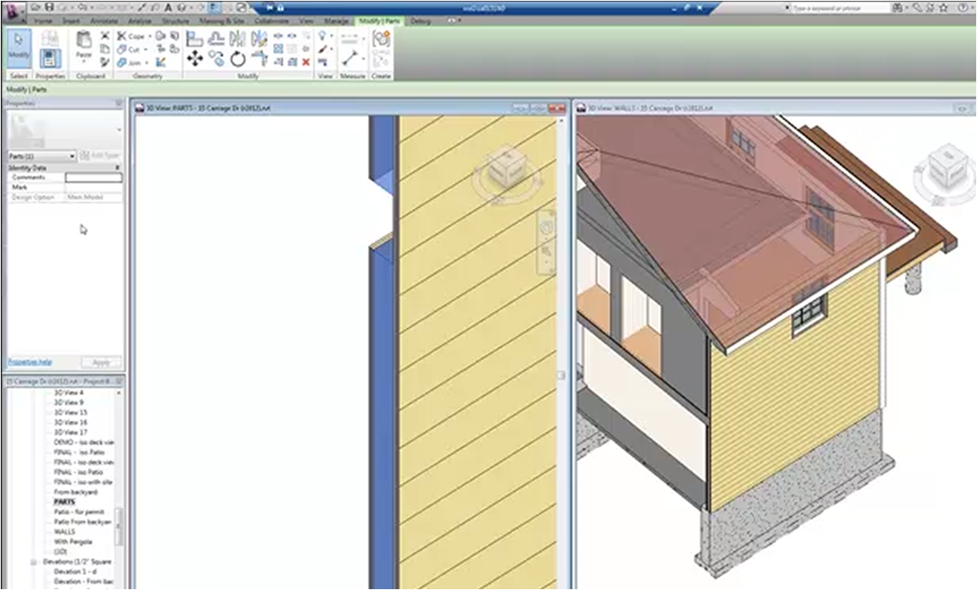
Construction Modeling
Parts
Division of model element into discrete parts
Help in independent scheduling, tagging, filtering and export
Can be divided further into smaller parts
Parts automatically update to reflect changes in base element
Assemblies
Aggregation of multiple instances to create an assembly
Elements in assembly can be manipulated as single unit
Multiple placement of unique assembly type
Can be used to generate sheet and assembly views (listed under assembly in Project Browser)
New API
Allows elements to be
divided into sub-parts
collected into assemblies
displayed in special assembly views
Notes:
In Revit, many elements can be divided into parts that can be independently scheduled, tagged, filtered and exported. The part element is designed to support aspects of construction workflows such as pour schedules. Parts can be generated from elements with layered structures like walls, floors, roofs, ceilings, structural slab foundations. Parts are automatically updated and regenerated when the original element from which they are derived gets modified.
Assemblies are combination or aggregation of multiple model elements which can then be edited, tagged, scheduled and filtered. All the elements in an Assembly are manipulated as single unit and can be placed over multiple times. These assemblies help generate sheet and assembly views and are listed under Project Browser under Assembly node.
With the new API, we can divide an element into parts and collect individual instances into assemblies. We can also create various special assembly views.

Slide 29
Construction Modeling
Assembly Type and Instance
Autodesk.Revit.DB.Assembly.AssemblyInstance
Combines multiple elements for tagging, filtering, scheduling and creating isolated assembly views
Autodesk.Revit.DB.Assembly.AssemblyType
Refers to the type for construction assembly elements
Member access
AssemblyInstance.GetMemberIds() - get assembly instance member element ids
AssemblyInstance.SetMemberIds() - set assembly instance member element ids
Notes:
AssemblyInstance helps combine multiple elements for tagging, filtering, scheduling and creating isolated assembly views
AssemblyType refers to the type of construction assembly elements
To work with each elements that form an assembly, we can use the GetMemberIds or SetMemberIds.

Slide 30
Construction Modeling
Assembly Views
AssemblyViewUtils – utilities to create assembly views
Create3DOrthographic()
CreateDetailSection()
CreateMaterialTakeOff()
CreatePartList()
CreateSheet()
Assembly views display only elements in assembly that are created using this class
Parts Utilities
Provide a set of static methods for creation and manipulation of parts
CreateParts()
DivideParts()
GetAssociatedParts() – return all parts associated with the given elements
GetDividedParents() – return an set of elements that leads to the creation of the given part
Others
Notes:
AssemblyViewUtils are utilities which help create assembly views. The view types that can be created can be Orthographic, Detail sections, material take off schedules or we can also create a schedule of parts, and sheets.
PartUtils provides methods to describe the relationships between parts and elements. These provide a set of static methods for creation and manipulation of parts like CreateParts(), DivideParts(), GetAssociatedParts(), GetDividedParents(), etc.

Slide 31
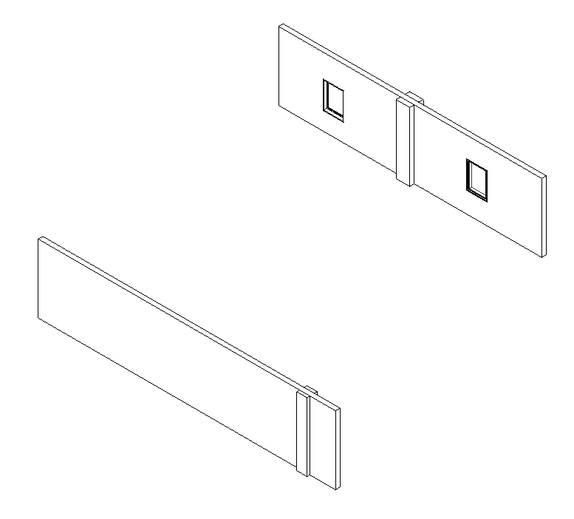
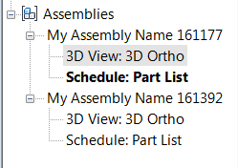
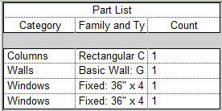
Construction Modeling
Demo

Slide 32
Point Cloud
Point Cloud Engine and Client API

Slide 33
Point Cloud APIs
Three types of APIs:
Client API
Create and manipulate point cloud instance within Revit
Custom Point Cloud Engine API
Supply points in a point cloud to Revit
Point Cloud Indexer API
Convert data from custom format to indexed (.pcg) format read by Revit and other Autodesk products
C/C++ API
Documented in SDK 'Point Cloud Indexing API' subfolder
Not covered today
Notes:
There are three sets of APIs related to point clouds –
Client API is capable of working with point cloud instances within Revit and help in creating them, manipulating their properties and reading the points found matching to a given volumetric filter.
The point cloud engine API is capable of supplying points in a point cloud to Revit.
The point cloud indexer API helps convert data from a custom format to indexed (pcg) format that Revit and other Adsk products can read. It has a C/C++ API and more details on this API can be located in the word document found in the SDK folder as specified in the slide. This Indexer API is not being covered in today’s presentation.

Slide 34
Point Cloud Client API
Autodesk.Revit.DB.PointClouds namespace
Major classes
PointCloudInstance
PointCloudType – represent the points obtained from a single file or engine identifier
CloudPoint – an individual point. (x, y, z) in cloud coordinate, and a color
PointCollection
PointCloudFilter – volume filter. Use PointCloudFilterFactory.CreateMultiPlanerFilter()
Two ways to access
IEnumerable – traditional “for each” access IPointCloudEngine interface
GetPointBufferPointer()
Direct access to the unmanaged world
C# or C++/CLI only
Unsafe
Performance gain
Notes:
New classes, interfaces, and structure for Revit Point Cloud are added in PointClouds namespace.
The major classes of the client API are listed below –
PointCloudInstance – deals with the instance of point cloud in a location
PointCloudType – represents the points obtained from a single file or engine
CloudPoint – refers to an individual point cloud point (representing a coordinate and color).
PointCollection- as the name suggests, refers to a collection of points obtained from instance and filter
PointCloudFilter – refers to the volumetric filter used to filter points as per specific region of interest
Two ways to access the points as client –
Using the traditional IEnumerable interface, we can iterate through the resulting points from the point collection
In unsafe interface usable only from C# and C++, we can get a pointer to the point storage collection and access each one in memory using the GetPointBufferPointer(). This might even have performance gain while traversing through large buffers of points.

Slide 35
Point Cloud Client API
Tools to interact with the user
PointCloudInstance.SetSelectionFilter()
PointCloudInstance.FilterAction – Highlight/Isolate
Selection.PickBox()
e.g. prompt the user to select a portion of the cloud, and creates a highlight
Notes:
There are two API tools to help client applications interact with the user:
The SetSelectionFilter method and FilterAction property of PointCloudInstance allows API users to specify volumetric filter to a cloud. The parts of the cloud that pass this filter will be rendered differently from the rest of the cloud, with highlighting done with blue highlight color.
Selection.PickBox() invokes a two click selection that lets users specify a rectangular area on the screen. This returned box generates a filter and either highlights or isolates the selected points in the cloud.

Slide 36
Point Cloud Engine API
Custom engine implementation
IPointCloudEngine – register by PointCloudEngineRegistry
IPointCloudAccess – response to inquiries about the properties of a single point cloud. Methods: GetName(), ReadPoints(), etc.
IPointSetIterator – returns sets of points to Revit. methods: ReadPoints(), Free()
File-based and non-file-based
File-based – select a point cloud file from external file (like .pcg, e.g., .xml)
Non-file-based – can be from anywhere (e.g., database, server)
Notes:
The API to allow you to create your own Point Cloud engine and let Revit interact with it to display, select, snap and perform other operations on the Point Cloud.
You must implement IPointCloudEngine, IPointCloudAccess, and IPointSetIterator interface to create our own engine.
IPointCloudEngine interface provides an entry point for the Point Cloud access to Revit. An implementation of this interface is registered with Revit.
Revit then uses the methods of IPointCloudAccess to respond to inquiries from Revit regarding properties of single point cloud. ReadPoints method of IPointCloudAccess interface provides Revit a filtered set of points from Point Cloud.
And IPointSetIterator interface gets points form the Point Cloud. ReadPoints method of IPointSetIterator interface allows Revit to iterate points in Point Cloud.
Cloud Engine implementation can be either file based or non-file based.
File based implementations require each point cloud to be mapped to single file on disk.
Non-file based engine implementations obtain point clouds from any source – database, server, one part of larger aggregate file, etc.

Slide 37
Revit Structure
Migration and rebar enhancement

Slide 38
Updates to Revit Structure API
AnalyticalModel now derived from Element, not IDisposable
AnalyticalModel object is DB resident
Analytical model curve only included in AnalyticalModel instance
New RebarHostData methods
GetExposedFaces()
GetCommonCoverType()
GetRebarsInHost(), GetAreaReinforcementsInHost(), GetPathReinforcementsInHost()
NewBeamSystem() now requires Level or SketchPlane argument
NewTruss() requires SketchPlane input
Notes:
Because of the split between the analytical model and physical model of structural components in RST product,
one impact on API is that the AnalyticalModel object is now a database resident. It is now derived from Element class, instead of IDisposble interface. The methods and properties of class AnalyticalModel are not changed, so in existing add-ins are unaffected.
Another impact is that the Analytical model curve is only included in AnalyticalModel instance. In previous versions, the analytical curves was included in both the Geometry property and the AnalyticalModel instance. If your code reads analytical curve from the Geometry property, you would have to update it to read analytical curve from the analytical model.
RebarHostData contains more powerful APIs. Calling GetExposedFace method you can get all faces that have an associated CoverType, and GetCommonCoverType method gets the common CoverType of the host.
GetRebarsInHost method can return all rebars in the host structural component. GetAreaReinforcementsInHost and GetPathReinforcementsInHost can return area reinforcement and path reinforcement data respectively.
The family of NewBeamSystem() methods has changed. Previously curves could be input without a sketch plane or level as input, and the orientation of the active view would determine the orientation of the resultant beam system. Now, there are overloads accepting either the sketch plane or the level and those inputs are required. The overloads of NewBeamSystem() now check that the input profile curves lie properly in the sketch plane or level. They also check to ensure that the profile forms a closed loop.
The SketchPlane input for NewTruss() method is now required. Previously null could be input, and the orientation of the active view would determine the orientation of the resultant truss.

Slide 39
Updates on Rebar API
Big changes in rebar shape related APIs
Steps to create rebar shape
Methods to create/edit rebar shape
ElementId of shared parameter must be the argument throughout rebar shape definition methods
Main work of migration
Minor changes
Element creation APIs are moved to its representing class
Document.Create.NewRebarHookType → RebarHookType.Create
Document.Create.NewRebar →Rebar.CreateFromCurves & Rebar.CreateFromRebarShape
Notes:
The APIs to create and edit rebar shape have undergone considerable changes.
First change is the steps to create Rebar shape
In 2011, the steps were:
Create a RebarShape inside the Document.
Create a RebarShapeDefinition inside the RebarShape.
Add data to the RebarShapeDefinition.
Commit the RebarShape.
In 2012, the steps are:
Create a RebarShapeDefinition. (It refers to the Document, but is not inside the document.)
Add data to the RebarShapeDefinition.
Create a RebarShape inside the Document based on the RebarShapeDefinition. (Only now is the document modified.)
The second changes are the changes of methods.
the following methods are removed:
Autodesk.Revit.Creation.Document.NewRebarShape()
RebarShape.NewDefinitionBySegments()
RebarShape.NewDefinitionByArc()
and replaced by:
RebarShape.Create(Document, RebarShapeDefinition, ... )
The RebarShapeDefinitionBySegments constructor.
The RebarShapeDefinitionByArc constructors.
In Revit 2011, Shared parameter is used in the methods to define the rebar definition shape. Now ElementId of the shared parameter is used in those methods. RebarShapeParameters class provides method to obtain ElementId the corresponding shared parameter.
Because of these big changes, the main work of RST plug-ins is for rebar shape creation. The code have to be updated according to these changes. For anything about the code migration, please Search the What’s New section in RevitAPI.chm file. It explains the reason.
The minor changes related rebar are the method to create the rebar hook type is a static method RebarHookType class, and the method is renamed to Create. Overloaded methods to create rebar are moved to be static member methods of Rebar class and we now have exclusive methods called CreateFromCurves and CreateFromRebarShape to create new rebars. They no longer return null for invalid arguments, and they no longer regenerate the document.

Slide 40
Break
Be right back...

Slide 41
Extensible Storage
Extensible Storage
Notes:
Hello, welcome back from the break. My name is Jeremy Tammik, and just like Saikat I work in the AEC workgroup of the ADN Devtech team.
One of the main purposes of the BIM model is to store data, and obviously a custom application will often need to store custom data. Depending on circumstances, this data may or may not be visible to and modifiable by the end user. Until now, the only possibility to add custom data to a Revit model involved the use of shared parameters, which was limited in various ways. The new Extensible Storage API changes this in Revit 2012.

Slide 42
Extensible Storage
Create your own class-like data structure schema
Attach schema instances to any Element in a Revit model
Replaces technique of storing data in hidden shared parameters
Schema-based data is saved with the Revit model
Supports high-level, metadata-enhanced, object-oriented data
Read and/or write by all, only vendor, or only single specific app

Slide 43
Storing Data on an Element
Create and name a new schema
Set the read/write access for the schema
Define one or more fields of data for the schema
Create an entity based on the schema
Assign values to the fields for the entity
Associate the entity with a Revit element
Classes involved
Schema class represents a schema
Instances are created by SchemaBuilder class
Fields created by FieldBuilder class
Entity class holds data for a Schema instance
Entity is attached to an arbitrary Revit Element
Demo and further reading
ExtensibleStorage sample application
ExtensibleStorageManager SDK sample
Developer Guide Chapter 22.5 Extensible Storage

Slide 44
Compound Structure and Wall Sweeps
Compound Structure and Wall Sweeps

Slide 45
Uniting and Subdivision of Elements
Addressed by several areas in the Revit 2012 API
Construction modelling
Grouping via assemblies
Splitting via element parts
Split face data is now accessible
Face HasRegions property and GetRegions method
FaceSplitter class accesses elements produced by Split Face operation
Compound structure provides read/write access to layers
Limited access in Revit 2011, no write or creation access at all

Slide 46
Compound Structure
Read, write and creation of all of compound structure layer info
Includes vertical regions, sweeps and reveals
New CompoundStructure class
Layers property replaced by GetLayers and SetLayers methods
CompoundStructureLayer properties modified

Slide 47
Wall Sweeps
New WallSweep class represents a wall sweep or reveal
Either standalone or added by the compound structure settings
Static method Create creates new standalone sweep or reveal

Slide 48
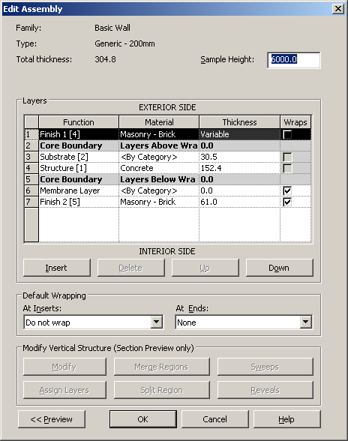
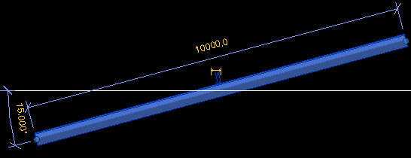
Compound Structure and Wall Sweep Demo
CompoundStructure SDK sample
Create a vertical compound structure for walls
Create and assign new compound structure to selected wall type
Exercises the following methods:
HostObjAttributes methods GetCompoundStructure and SetCompoundStructure
CompoundStructure methods SetLayers, SetNumberOfShellLayers, SetParticipatesInWrapping, GetSegmentIds, GetAdjacentRegions, GetSegmentEndPoints, SplitRegion, FindEnclosingRegionAndSegments, AddWallSweep
Notes:
RvtSamples > Element > Create CompoundStructure for wall.
CompoundStructure.rvt sample model is missing in SDK: SPR #206270 [Errors in SDK sample CompoundStructure docs and execution].
Must be run in an imperial model, because it searches for a profile family named '8" Wide'.

Slide 49
Revit MEP 2012 API
Placeholders, Insulation, Lining, Pipe Settings

Slide 50
Revit MEP 2012 API Enhancements
Major
Pipe settings and sizes
Placeholder ducts and pipes
Duct and pipe insulation and lining
Minor
Spare and space circuits
Cable tray and conduit domain
Connector, MEPSystem and Space properties
Disconnection warnings
New MEP related APIs
Detailed Energy Analysis Model API
Conceptual Energy Analysis API
Notes:
A group of new classes provide read and write access to the MEP pipe settings.
The Duct and Pipe classes provide new methods to create placeholder elements and predicate properties to identify such elements.
New utility methods MechanicalUtils.ConvertDuctPlaceholders and PlumbingUtils.ConvertPipePlaceholdersMechanicalUtils convert a set of placeholder ducts and pipes to real 3D elements.
The new classes DuctInsulation, PipeInsulation, DuctLining and related types support read/write and create access to duct & pipe insulation and lining. In Revit 2012, these objects are now accessible as standalone elements related to their parent duct, pipe, or fitting.

Slide 51
Pipe Settings and Sizes
MEP pipe settings are now accessible programmatically
Read and write access
Static methods PipeSettings.GetPipeSettings and PipeSizeSettings.GetPipeSizeSettings return singleton objects

Slide 52
Placeholder Ducts and Pipes
Placeholder elements indicate a planned layout
System layout can be defined with min info, max flexibility
Convert into true duct and pipe elements later on
Size, slope and other properties can be assigned
MepPlaceHolder sample in DevDays Online recording
Two commands: CreatePlaceholders and ConvertPlaceholders
Updated source code included in this webcast support materials

Slide 53
Insulation and Lining
Before, family defined insulation and lining, triplicating geometry
Now insulation and lining can be added programmatically
New classes DuctInsulation, PipeInsulation, DuctLining
Applicable to duct, pipe, and fitting
Support read, write and create access
Accessible as standalone element related to parent
Notes:
The new classes DuctInsulation, PipeInsulation, DuctLining and related types support read/write and create access to duct and pipe insulation and lining. In Revit 2012, these objects are accessible as standalone elements related to their parent duct, pipe, or fitting.

Slide 54
Small Enhancements and Changes
Spare and space circuits
A new ElectricalSystem.CircuitType property identifies the type of an electrical circuit (circuit, spare or space), and the ElectricalSystem.AddToCircuit method throws an exception when the system is a spare or space circuit
Cable tray and conduit domain
The Autodesk.Revit.DB.Domain enumeration adds a new value to represent cable tray and conduit
Connector
New read-only properties added for JointType, GenderType and EngagementLength
MEPSystem
New property MEPSystem.IsEmpty
Graphical warnings for disconnects
New ‘show graphical warning’ properties and setters on the Application class
Space properties
New property Space.BaseHeatLoadOn indicates if the value of Space.LatentHeatGainperPerson and Space.SensibleHeatGainperPerson properties has the default value or is user defined
Fitting methods
Document methods to create new fittings no longer remove unused or dangling curve connectors

Slide 55
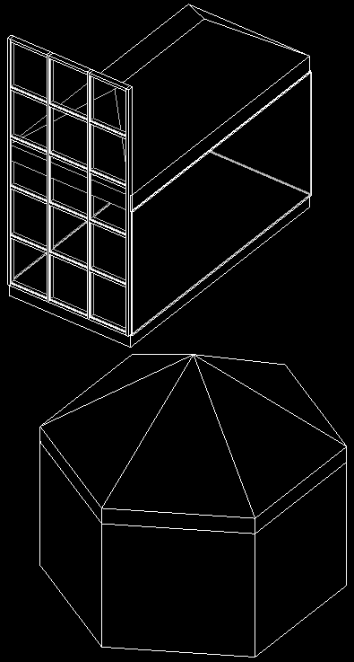
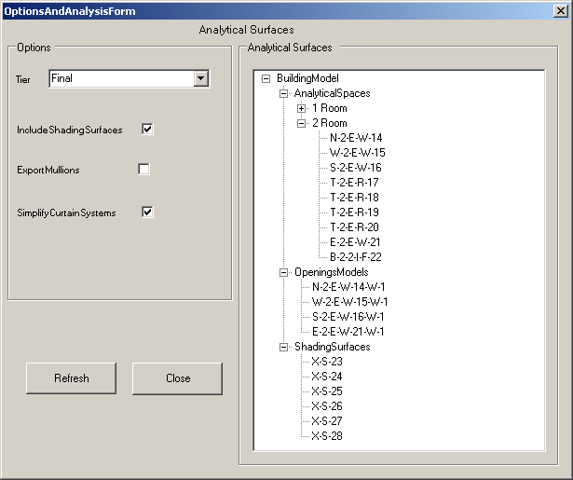
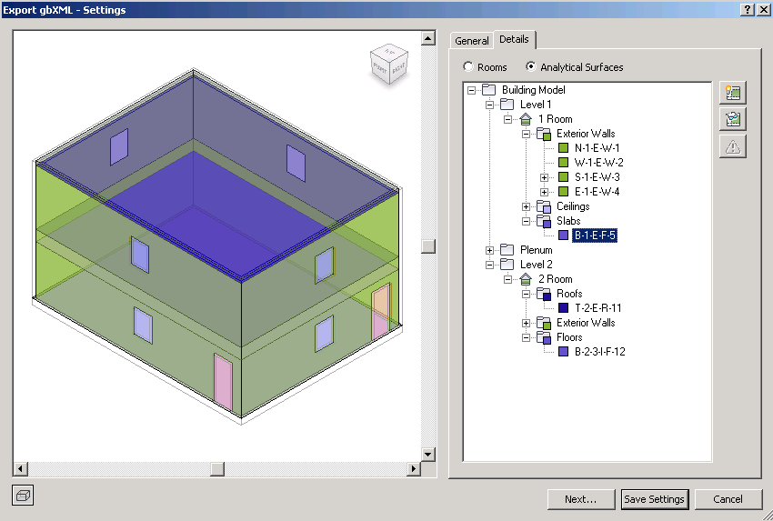
Detailed Energy Analysis Model API
Produce analytical thermal model from physical building model
Retrieve energy analysis detail model and present as tree view
Similar to Export to gbXML and Heating and Cooling Loads
Model is composed of spaces, zones and planar surfaces
EnergyAnalysisDetailModel.Create()
Methods GetAnalyticalSpaces, Surfaces, Openings, ShadingSurfaces
Demo: EnergyAnalysisModel SDK sample
Notes:
Open C:\a\lib\revit\2012\SDK\Samples\GeometryAPI\EnergyAnalysisModel\EnergyAnalysisModel.rvt.
Run RvtSamples > Analysis > EnergyAnalysisModel.
EnergyAnalysisDetailModelTier specifies level of computation detail for energy analysis model.
This new API provides access to the contents of a project's detailed energy analysis model, as seen in the Export to gbXML and the Heating and Cooling Loads features.
This analysis produces an analytical thermal model from the physical model of a building. The analytical thermal model is composed of spaces, zones and planar surfaces that represent the actual volumetric elements of the building.
New classes in Autodesk.Revit.DB.Analysis namespace for the energy analysis detail model itself, creation options, openings, spaces, surfaces and loops can be used to generate and analyze the contents of the detailed energy analysis model. The EnergyAnalysisDetailModel Create method creates and populates the model with appropriate options selected. The methods GetAnalyticalSpace, GetAnalyticalSurfaces, GetAnalyticalOpenings and GetAnalyticalShadingSurfaces extract entities from the analysis model. The method Destroy cleans up the Revit database after finishing with the analysis results.

Slide 56
Conceptual Energy Analysis API
Energy analysis on conceptual design models
New overload of Document.Export method taking MassGBXMLExportOptions argument
Create a gbXML file containing energy analysis elements generated from conceptual mass family instances
Notes:
New classes in the Autodesk.Revit.DB.Analysis namespace provide access to the elements and objects created by Revit to perform energy analysis on conceptual design models. The method Document Export method overload taking a MassGBXMLExportOptions argument exports a gbXML file containing conceptual energy analysis elements (mass elements) only.

Slide 57
New SDK Samples
Quick tour of new SDK samples

Slide 58
New Samples in Revit 2012 SDK
CreateFillPattern
CompoundStructure
EnergyAnalysisModel
ExtensibleStorageManager
PerformanceAdviserControl
PointCloudEngine
MultiplanarRebar
MultithreadedCalculation
SlaveSymbolGeometry
GeometryCreation_BooleanOperation
ProximityDetection_WallJoinControl

Slide 59
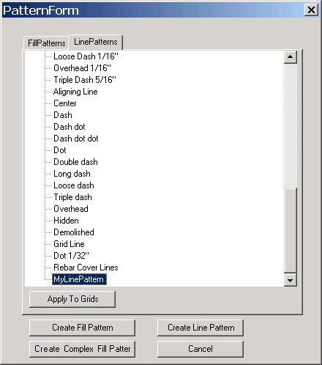
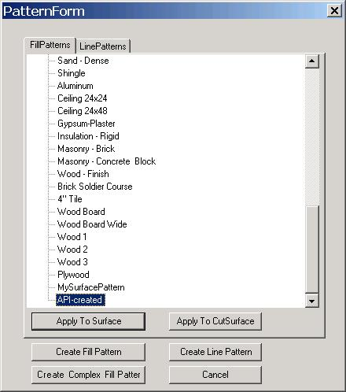
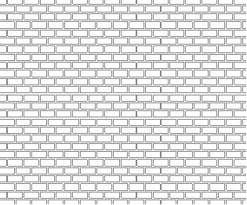
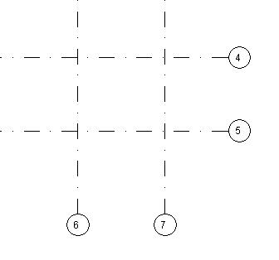
Create Fill Pattern
Create and retrieve fill and line patterns
Apply to a selected surface or grid
Main classes and methods:
FillPattern, FillGrid, FillPatternElement.Create(doc, fillPattern) LinePattern, LinePatternSegment, LinePatternElement.Create( doc, linePattern)
Notes:
This sample demonstrates how to create or retrieve a FillPatternElement or LinePatternElement and apply them to the surface or grid.
To run: open the rvt file provided in the SDK (“CreateFillPattern.rvt”).
Select a wall, and RvtSamples > Elements > Create and set Fill Pattern. You add fill pattern.

Slide 60
CompoundStructure
Create a vertical compound structure for walls
Create and assign new compound structure to selected wall type
Main classes and methods:
HostObjAttributes methods GetCompoundStructure and SetCompoundStructure
CompoundStructure methods SetLayers, SetNumberOfShellLayers, SetParticipatesInWrapping, GetSegmentIds, GetAdjacentRegions, GetSegmentEndPoints, SplitRegion, FindEnclosingRegionAndSegments, AddWallSweep
Notes:
RvtSamples > Element > Create CompoundStructure for wall.
CompoundStructure.rvt sample model is missing in SDK: SPR #206270 [Errors in SDK sample CompoundStructure docs and execution].
Must be run in an imperial model, because it searches for a profile family named '8" Wide'.

Slide 61
EnergyAnalysisModel
Produce analytical thermal model from physical building model
Retrieve energy analysis detail model and present as tree view
Similar to Export to gbXML and Heating and Cooling Loads
Model is composed of spaces, zones and planar surfaces
EnergyAnalysisDetailModel.Create()
GetAnalyticalSpaces, GetAnalyticalSurfaces, GetAnalyticalOpenings, GetAnalyticalShadingSurfaces
Notes:
Open C:\a\lib\revit\2012\SDK\Samples\GeometryAPI\EnergyAnalysisModel\EnergyAnalysisModel.rvt.
Run RvtSamples > Analysis > EnergyAnalysisModel.
EnergyAnalysisDetailModelTier specifies level of computation detail for energy analysis model.
This new API provides access to the contents of a project's detailed energy analysis model, as seen in the Export to gbXML and the Heating and Cooling Loads features.
This analysis produces an analytical thermal model from the physical model of a building. The analytical thermal model is composed of spaces, zones and planar surfaces that represent the actual volumetric elements of the building.
New classes in Autodesk.Revit.DB.Analysis namespace for the energy analysis detail model itself, creation options, openings, spaces, surfaces and loops can be used to generate and analyze the contents of the detailed energy analysis model. The EnergyAnalysisDetailModel Create method creates and populates the model with appropriate options selected. The methods GetAnalyticalSpace, GetAnalyticalSurfaces, GetAnalyticalOpenings and GetAnalyticalShadingSurfaces extract entities from the analysis model. The method Destroy cleans up the Revit database after finishing with the analysis results.

Slide 62
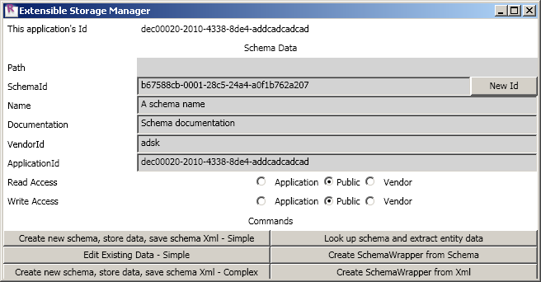
ExtensibleStorageManager
Create, read, update, and delete extensible storage data
Contains two projects
SchemaWrapperTools
C# library
Encapsulates Schema, SchemaBuilder, Field, and FieldBuilder classes
Display all data of a particular Schema in an Entity
Serialize schema data to and from disk
ExtensibleStorageManager
External command and application
Launches a WPF dialog to interact with SchemaWrapper
View data and schemata serialized into Revit elements

Slide 63
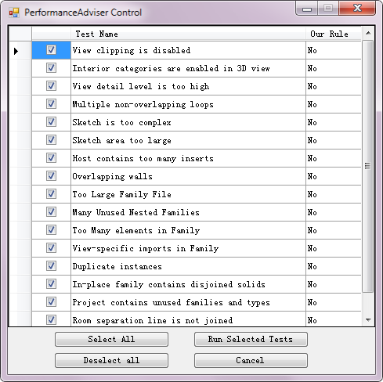
PerformanceAdviserControl
Demo usage of the PerformanceAdviser API
Select rules to be run on elements, performance and criteria tests
Show warnings for elements meeting the selected rules' criteria
Create and register custom API-based rules
Notes:
Allow user to select certain performance and criteria tests to be run on the elements of the active document. It also demonstrates how to create custom API-based rules and register them with PerformanceAdviser.
Open C:\a\lib\revit\2012\SDK\Samples\PerformanceAdviserControl\DoorsAndWalls.rvt.
Run RvtSamples > Elements > PerformanceAdviserControl.

Slide 64
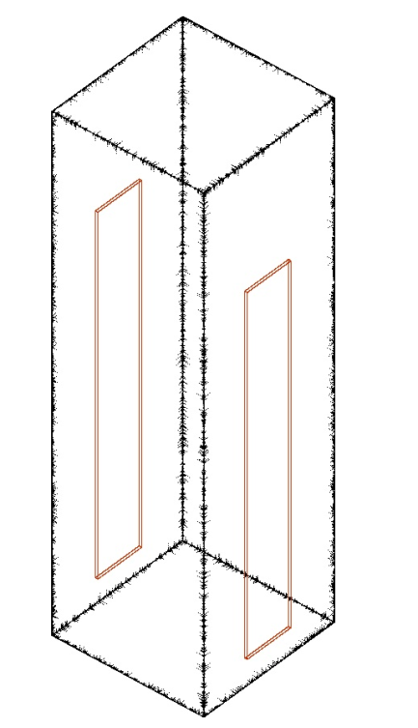
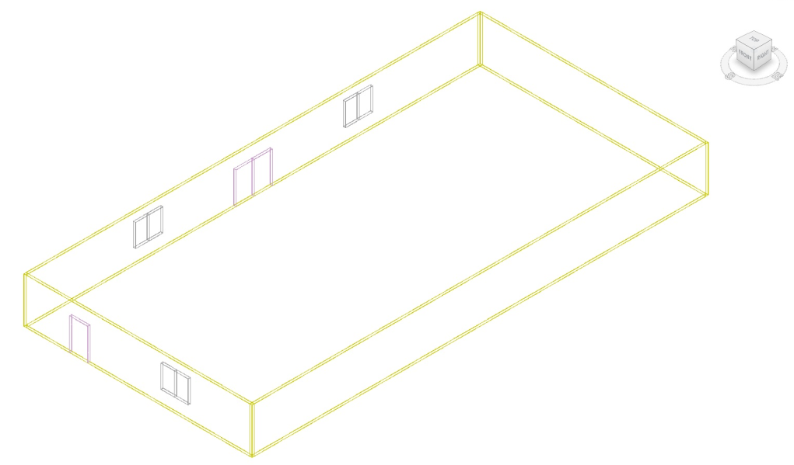
PointCloudEngine
Point Cloud represented by 3D cells
Point Cloud Engine types for file based and non-file-based point clouds
Interfaces to implement Point Cloud engines
IPointCloudEngine
IPointCloudAccess
IPointSetIterator
Register Point Cloud engine
Export Point Cloud
Notes:
This sample demonstrates how to create Point Cloud engines for Point Cloud represented by 3 dimensional cells. Engines can be categorized either file based or non-file-based. In this sample, 3D cell representation in a xml file is used for a file based engine and hard-code cells for none-file based engine. Three interfaces IPointCloudEngine, IPointCloudAccess, and IPointSetIterator must be implemented for an engine. The engine has to be registered to Revit. Revit interacts with an engine through these interfaces to display, select, snap, and perform other operations on the point cloud. The sample also shows how to export the point cloud to an external file.

Slide 65
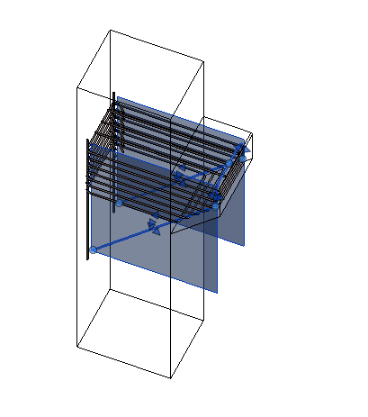
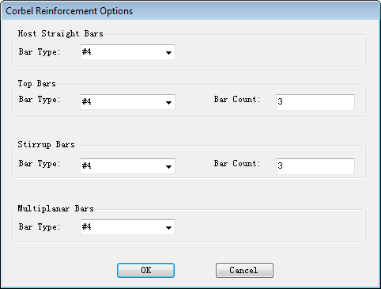
MultiplanarRebar
Demonstrate reinforcement of sloped corbel
Create multiplanar rebar shape, straight vertical, stirrup and 3D rebar for the selected corbel

Slide 66
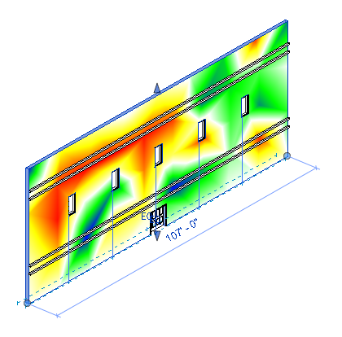
MultithreadedCalculation
Create analysis data in separate thread
Display it on a preselected element
Uses current view's SpatialFieldManager to show the analysis results
Implements IUpdater to update analysis data on element geometry changes
The type of the sender arg to the Idling event handler changed.
The first two lines in UpdateWhileIdling():
Application app = sender as Application;
UIApplication uiApp = new UIApplication(app);
need to be replaced with:
UIApplication uiApp = sender as UIApplication;
Notes:
Open C:\a\lib\revit\2012\SDK\Samples\AnalysisVisualizationFramework\MultithreadedCalculation\MultithreadedCalculation.rvt.
Run RvtSamples > AnalysisVisualizationFramework > MultithreadedCalculation.

Slide 67
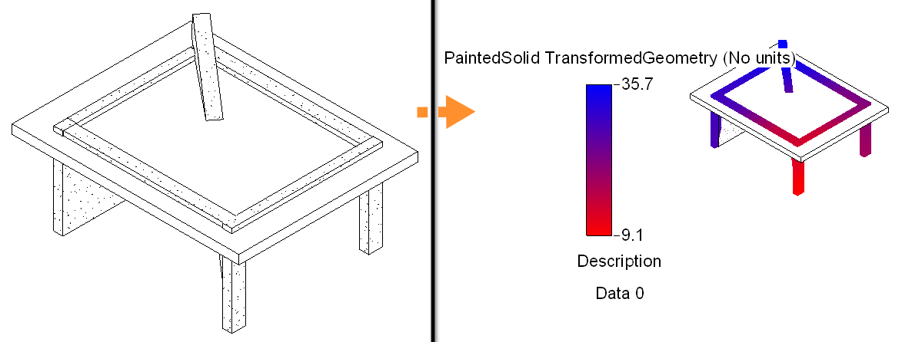
SlaveSymbolGeometry
Slave symbol geometry e.g. same door type used in different walls
Demonstrate access to family instance slave symbol geometry
Uses SpatialFieldManager to paint the geometry
Calls FamilyInstance methods to access geometry
get_Geometry(), GetOriginalGeometry(), GetTransformed()
Each geometry type is placed in a different view
Notes:
Open C:\a\lib\revit\2012\SDK\Samples\GeometryAPI\SlaveSymbolGeometry\SlaveSymbolGeometry.rvt.
RvtSamples > GeometryAPI > SlaveSymbolGeometry.
Q: Why do two different FamilySymbols have the same name in my Autodesk Revit document? A: In the Autodesk Revit API, Symbols represent geometry. Consider that two window instances of the same type are inserted into walls of different types. Now, these two window instances refer to the same FamilySymbol and count as being of the same type, but it is clear that they cannot possibly use the same symbol’s geometry, since inserting them into walls of different thickness changes each window’s geometry to match. To track individual instances of FamilySymbols, Autodesk Revit employs a “master” and “slave” functionality with “slave” FamilySymbols localizing their geometry to surrounding conditions according to the “master” FamilySymbol template. If there is no door instance in a model, there is only one “master” FamilySymbol for a 36”x84” door, but if a door is inserted, Autodesk Revit will create a “slave” FamilySymbol for the new 36”x84” Door. Subsequent doors placed in the model will cause Autodesk Revit to generate additional “slave” FamilySymbols.

Slide 68
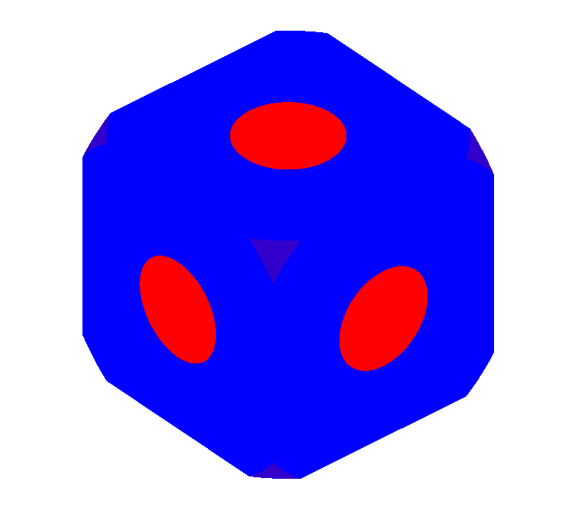
GeometryCreation_BooleanOperation
Create geometry solid
Apply geometric Boolean operations
Create constructive solid geometry
View solid using Analysis Visualization Framework (AVF) PaintSolid
Notes:
This sample demonstrates how to create the geometry solid using GeometryCreationUtils and operate the geometric Boolean operation using BooleanOperationUtils. This project creates a constructive solid geometry CSG tree and shows it in a new view using AVF, the Analysis Visualization Framework.

Slide 69
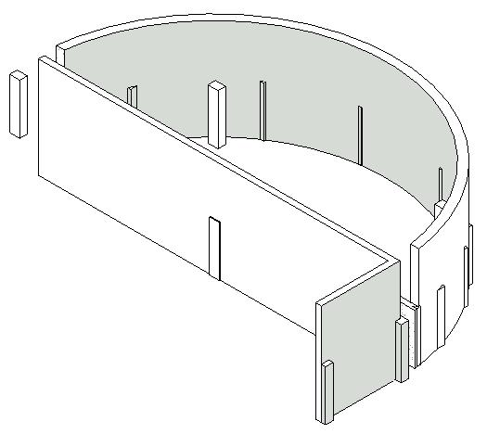
ProximityDetection_WallJoinControl
Four functionalities:
1) find columns in walls, 2) find elements blocking door ways, 3) find walls at the end of walls, and 4) check walls join/disjoin states.
Main classes and methods:
ElementIntersectsElementFilter, ElementIntersectsSolidFilter, GeometryCreationUtilities.CreateExtrusionGeometry(), WallUtils.IsWallJoinAllowedAtEnd(), WallUtils.(Dis)allowWallJoinAtEnd(), LocationCurve.ElementsAtJoin(),
Notes:
This sample demonstrates how to: find columns in wall, find elements blocking egress, find walls (nearly) joined to end of walls and check walls join/disjoin states using the ElementIntersectsSolidFilter, ElementIntersectsElementFilter and WallUtils classes.
To Run: RvtSamples > Geometry > Proxmity Detection and Wall Join Control.

Slide 70
Conclusion

Slide 71
Summary
Revit 2012 New Product Features
Overview: API and SDK
Migrating Revit 2011 add-ins to Revit 2012
Revit 2012 New APIs
Geometry API
Construction modeling
Point Clouds
Updates in Revit Structure API
Break
Extensible Storage
Compound Layer Structure
Updates in Revit MEP API
New SDK samples
Conclusions
Notes:
We have covered…

Slide 72
Learning More
Online Help, Developer's Guide and SDK Samples
Recording of Revit API Webcast
http://www.adskconsulting.com/adn/cs/api_course_sched.php
Developer Days online for Revit 2012, Family API, MEP, etc. (some are from last year, but still applicable)
Discussion Groups
http://discussion.autodesk.com > Revit Architecture > Revit API
API Training Classes
http://www.autodesk.com/apitraining
The Building Coder, Jeremy Tammik's Revit API Blog
http://thebuildingcoder.typepad.com
Autodesk Developer Network
http://www.autodesk.com/joinadn
DevHelp Online for ADN members
http://adn.autodesk.com

Slide 73
Revit API Training and Consulting
Class room training
June 1-2 Farnborough, UK
July 14-15 Waltham, MA, USA
July 28-29 Beijing, China (in Chinese)
Register at: Developer Center > API Training and Consulting > Schedule
http://www.adskconsulting.com/adn/cs/api_course_sched.php

Slide 74
Revit API Wishlist Survey, Spring 2011
The Revit API wishlist survey is currently open at
http://www.zoomerang.com/Survey/WEB22C9QACTE6V
Or go to The Building Coder blog and select May 16th http://thebuildingcoder.typepad.com/blog/2011/05/api-wishlist-survey.html
Or from ADN site headline http://adn.autodesk.com
Deadline: June 3, 2011
This is your chance to raise your voice and influence the future API enhancement planning.
We appreciate your feedback.

Slide 75
Today’s presentations…
Recorded and posted at:
ADN Extranet
Revit > Knowledgebase > Whitepapers and Training Videos
Developer Center
API Training & Consulting > Schedule

Slide 76
Polls
How was the audio quality of the presentation
Good, acceptable, poor
How was the visual quality of the presentation?
Good, acceptable, poor
How do you rate the presentation materials?
Excellent, Good, Okay, Poor
How do you rate the presentation delivery?
Excellent, Good, Okay, Poor
Would you recommend this webcast to a friend or colleague?
Yes, No
What topics would you be interested in for future webcasts?
Worksharing API, Analysis Visualization Framework, Point Cloud API, Performance Adviser, IFC export

Slide 77
Questions and Answers

Slide 78
Thank you!
® 2011 Autodesk Developer Network

Slide 79
